Slide 1
Organization Structure

Slide 2
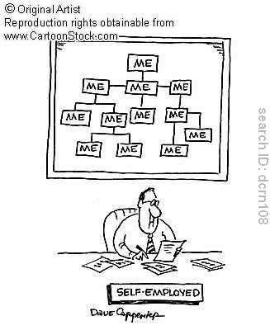
Why Organizational Structure?

Slide 3
Organizational Structure
Structure helps to control and coordinate the activities to optimize value addition.
Organizational structure has a strong influence on people.
There is no “right way” to design an organization.

Slide 4
Dimensions of Structure
Administrative component – no. of line supervisors, managers, and staff personnel relative to total number of employees
Autonomy
Centralization – concentration of power arrangements, locus of decision-making
Complexity – no. of occupational specialties, professional activity, professional training of employees
Delegation of authority
Differentiation – no. of specialty functions
Formalization – defining employees’ roles through formal documentation
Integration – extent of collaboration among departments, feedback and coordination mechanisms
Span of control – no. of subordinates that an individual manager can and should supervise
Standardization – range of variation tolerated within rules defining the jobs
Vertical span – no. of levels in the authority hierarchy from the top to the bottom

Slide 5
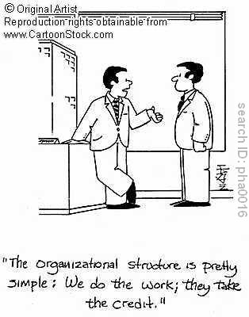
Complexity

Slide 6
Complexity
Refers to the degree of differentiation that exists within an organization.
Horizontal differentiation – degree of differentiation between units based on orientation of members, nature of tasks, education and training
Vertical differentiation – depth in structure, number in hierarchical levels
Spatial differentiation – geographical dispersion of organization’s offices, plants, personnel
Greater the differentiation, greater the complexity within the organization.
Greater need and difficulty of coordinating activities of diverse groups of employees

Slide 7
Horizontal Differentiation
Specialization: particular grouping of activities performed by an individual
Functional : jobs broken down into simple and repetitive tasks (division of labour)
Social : individuals, rather than their work, are specialized. Possess professional skills that cannot be routinized.
Greater the specialization, greater the complexity
Requires more sophisticated and expensive methods for co-ordination and control

Slide 8
Horizontal Differentiation
Departmentation: grouping of specialists; may be based on simple numbers, function, product or service, client, geography, or process.
Greater the departmentation, greater the complexity

Slide 9
Horizontal Coordination
Linking of activities across departments at similar levels
Methods:
Common resources
Information systems
Lateral relations
Direct contact
Liaison roles
Task forces and teams
Managerial integrators

Slide 10
Vertical Differentiation
A response to an increase in horizontal differentiation
Span of control: number of subordinates that a manager can effectively direct
Smaller the span, taller the organization
1
4
16
64
256
1024
4096
1
8
64
512
4096
Span : 8
Span : 4

Slide 11
Span of Control
Number of subordinates who report directly to a specific manager.
Factors influencing span of control:
Low interaction requirements
High competence levels
Work similarity
Low problem frequency and seriousness
Physical proximity
Few non-supervisory duties of manager
Available assistance
High motivational possibilities of work

Slide 12
Vertical Coordination
The linking of activities at the top level to middle and lower levels
Methods:
Formalization
Span of control
Centralization of power
Delegation
Line and staff positions

Slide 13
Importance of complexity
Greater the complexity, greater the need for effective communication, coordination and control devices.
Hence, creates different demands and requirements on managers’ time.
Paradox : economies created by complexity counterbalanced by the increased burden of keeping organization together

Slide 14
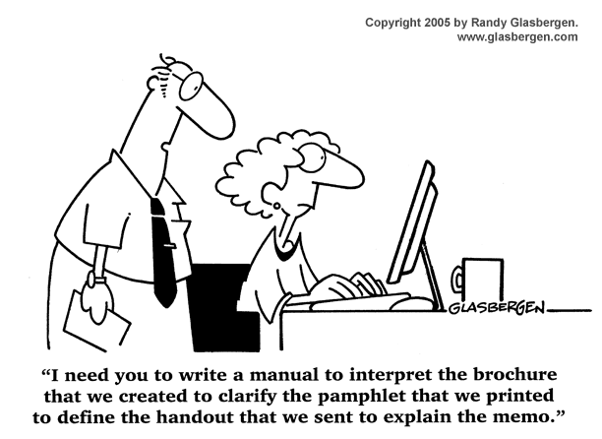
Formalization

Slide 15
Formalization
Written policies, rules, procedures, job descriptions and other process documents

Slide 16
Formalization
Refers to the degree to which jobs within the organization are standardized.
Individual discretion on job inversely proportional to extent of formalization.
Formalization can be explicit (written), or implicit (unwritten…perceived)
Degree of formalization can vary among and within organizations
Greater the professionalization of the job, lesser the likelihood of it being highly formalized
Formalization inversely related to level in hierarchy.
Extent of formalization differs with type of job (e.g. production jobs more formalized than research, in same organization)

Slide 17
Importance of Formalization
Standardization reduces variability in behavior
Standardization promotes coordination
Formalization → economy
Formalization :externalized behavior; Professionalization : internalized behavior
“make” or “buy” decision
Socialization

Slide 18
Formalization Techniques
Selection
Role requirements
Rules, procedures, policies
Training
Rituals

Slide 19
Formalization & Complexity
Strong association between specialization, standardization and formalization
Horizontal differentiation : functional
High formalization
Horizontal differentiation : social
low formalization

Slide 20
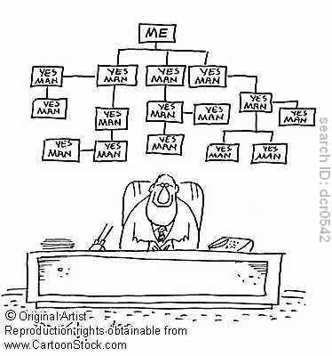
Centralization

Slide 21
Centralization
Refers to the degree to which the formal authority to make discretionary choices is concentrated in an individual, unit, or level (usually at the higher level)
Factors affecting centralization
Size
Geographical dispersion
Technological complexity
Environmental uncertainty

Slide 22
Main concerns
Formal authority
Centralization is concerned only with the formal structure, not the informal organization
Policies and decentralization
Centralization looks at decision discretion
“Concentration at a single point”
Concentration at a single point can refer to a single individual, unit or level, but the single point implies concentration at a high level.
IT and centralization
IT can improve top management's control, but decision choice still rests with low-level member
Control of information by lower level members
Control of information input is a form of de facto decentralization

Slide 23
Importance of the centralization-decentralization issue
Decentralization helps counter information overload
Decentralization facilitates speedy action and response
Decentralization can provide more input into decision-making
Decentralization motivates employees
Decentralization provides training opportunities for lower level managers
Centralization benefits whole organization, not any special-interest group
Some activities are done more efficiently when centralized.
Situational factors will determine the “right” amount of centralization required

Slide 24
Centralization, Complexity and Formalization
Centralization and Complexity
Inversely related
Centralization and Formalization
Ambiguous relationship

Slide 25
‘Superstructure’ :
depicted by the organization chart depicting departments and important reporting relationships in the organization
hierarchy
‘Infrastructure’ :
- roles performed by various organizational members
Extent of formal authority, extent of centralization, extent of formalization, extent of specialization
Essential for ensuring reliability and quality of work, accountability of various role performers

Slide 26
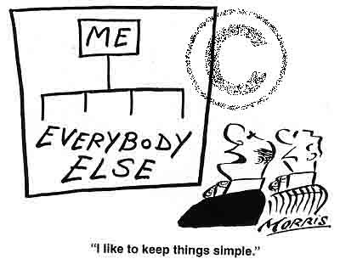
Organizational Configurations
Defined work activities
Reporting relationships
Simple
flat hierarchy, single head for coordination

Slide 27
Organizational Configurations (contd.)
Functional
Divisional
Self-contained autonomous unit groups, coordinated by a HQ unit
Matrix
Multiple reporting relationships
Ad Hoc
High horizontal diff, low vertical diff, high spatial diff, low forml, decentralization, flexibility
Virtual
High spatial diff
International
Global versions of functional, divisional, matrix

Slide 28
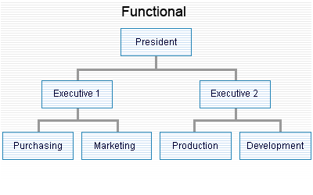
Functional Structure

Slide 29
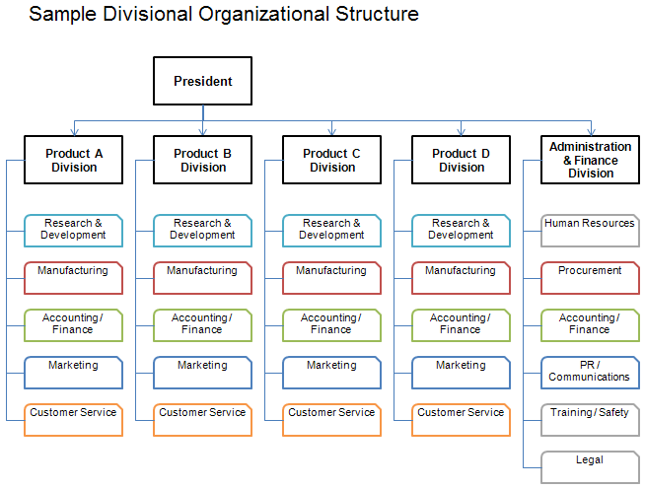
Divisional Structure

Slide 30
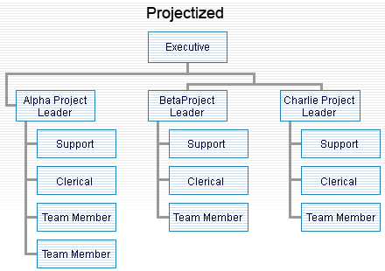
Project Structure

Slide 31
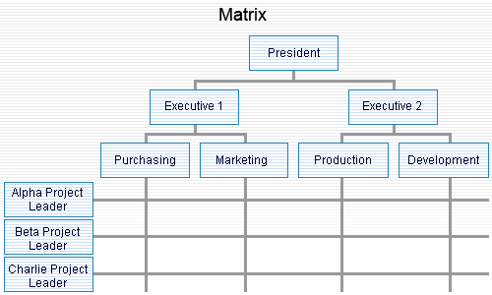
Matrix Structure

Slide 32
Functional structure
Activities grouped together by common functions from bottom to top of the organization
Strengths
Allows economies of scale within functional departments Enables in-depth knowledge and skill development Enables organization to accomplish functional goals Is best with only one or a few products
Weaknesses
Slow response time to environmental changes May cause decisions to pile on top, hierarchy overload Leads to poor horizontal coordination among departments Results in less innovation Involves restricted view of organizational goals

Slide 33
Divisional structure
Product structure, SBUs; grouping based on organizational outputs
Strengths
Suited to fast change in unstable environment Leads to client satisfaction because product responsibility and contact points are clear Involves high coordination across functions Allows units to adapt to differences in products, regions, clients Best in large organizations with several products Decentralizes decision making
Weaknesses
Eliminates economies of scale in functional departments Leads to poor coordination across product lines Eliminates in-depth competence and technical specialization Makes integration and standardization across product lines difficult

